Slide 1

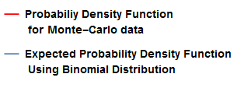
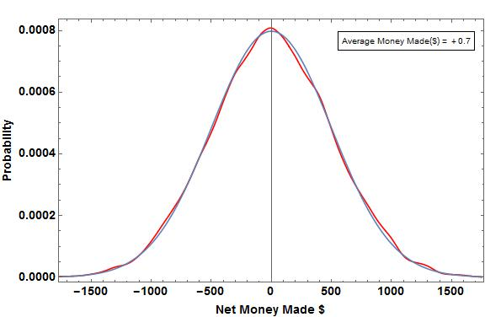
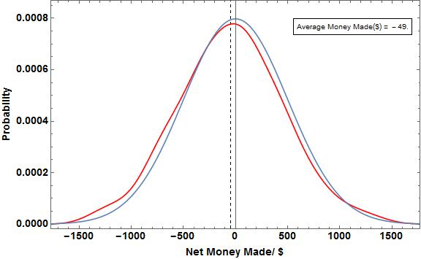
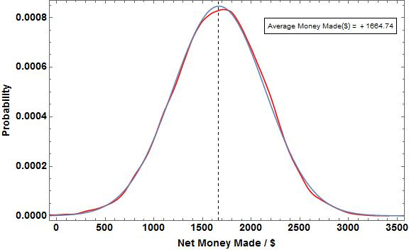
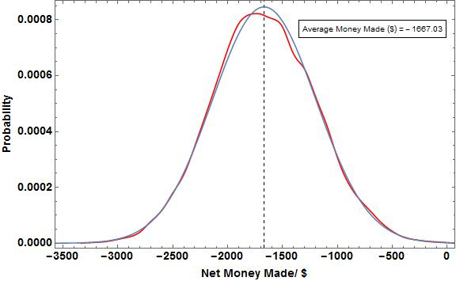

The Gambler’s Ruin: Mathematics of Risk-Taking
Omair Alam, Computational Methods in Physics, Spring 2015
Introduction:
Gamblers believe that random events are self-correcting therefore a long losing streak has to be followed by a wining streak because the numbers balance out over time. In order to test the validity of their belief we use Monte-Carlo simulations to calculate the average earnings or losses in a game of die rolls under varying conditions of winning. We further simulate a game of Craps with both a biased and unbiased die. For the Roll Die Game, we use a Binomial Distribution to model the expected earnings and for the Craps game, we use axiomatic derivations to calculate the expected probability of winning. We then compare the expected earnings with the actual earnings for a varying number of repetitions to understand the fate of the Gambler’s money after betting under certain game rules repeatedly.
Plots For Roll Die Game consisting of Expected and
Monte- Carlo Data
Results:
In Figure 1-4, the average money which is the physical mean of the data, represents the average of all the net sums made after each game (which consists of 100 trials).
For Figure 1, the average money made is very close to $0 because we used a fair die so we will on average lose and gain an equal amount of money, resulting in an average net amount being very close to 0.
For Figure 3, the average money is a big positive number, because the probability of winning is twice that of losing. This means that on average we will be winning in more trials than losing.
For Figure 4, the average money is a big negative number, because the probability of losing is twice that of winning. This means we will be, on average, losing much more money than winning.
Figure 2 also has a fair die but the number of repetitions are 100 times less than those for the game represented in Figure 1. The average money made in Figure 2 is therefore farther away from the expected value since the Law of Large Numbers dictates that we get closer to the expected value as the number of repetitions approach infinity. Therefore, a smaller number of repetitions results in an average value that has a greater deviation from the expected value.
Table 2 also represents the same principal. As the number of trials increase, the estimated probabilities of winning with both fair and unfair dies get closer to the axiomatic (expected) probabilities. Furthermore, the expected probability of winning with a fair die in Craps is very close to 0.5, making Craps the second most favorable Casino game for the gambler.[1]
Legend
Figure 1: Probability Distribution for a roll die game with a Fair Dye i.e. P(W) = P(L) for 10,000 repetitions of a game which consists of 100 trials. The Base Amount is $40,000, the score per win is $50, the lower-bound amount is $20,000 and the upper-bound amount is $80,000
Figure 2: Probability Distribution for a roll die game with a Fair Dye i.e. P(W) = P(L) 100 repetitions of a game which consists of 100 trials. The Base Amount is $40,000, the score per win is $50, the lower-bound amount is $20,000 and the upper-bound amount is $80,000
Physics and Methods:
Monte-Carlo methods were used as computational algorithms to approximate the probability of certain outcomes by running multiple trial runs using random variables.
We conducted two sets of experiments of which the first is related to rolling a die and the second is related to playing a game of Craps.
Die Roll Game Simulation:
The rules of the Roll Die Game are as follows:
We start with a base amount i.e. the money we start the game with,
Every roll, if we get a favorable die-face, we gain a certain amount otherwise, we lose the same amount,
We keep playing till we
Either get a net amount greater than a certain upper-bound amount, representing having made enough money to cash-out happily,
Or get a net amount lesser than a certain lower-bound amount representing having lost so much that more gambling isn’t possible,
Or if we exhaust the number of trails per game representing not having more time to play.
We find the frequencies of each net amount, and normalize the data to get the probabilities of attaining each net amount as well as the average earing.
We use the following Normal Distribution Formula in order to find the expected earnings for each Net Amount,
where N is the total number of steps, m is the number of steps required to reach the final destination, p is the probability of success and q is the probability of losing.
Figure 3: Probability Distribution for a roll die game with an Unfair Dye i.e. P(W) = 4/6 and P(L) = 2/6 10,000 repetitions of a game which consists of 100 trials. The Base Amount is $40,000, the score per win is $50, the lower-bound amount is $20,000 and the upper-bound amount is $80,000
Figure 4: Probability Distribution for a roll die game with an unfair Dye i.e. P(W) = 2/6, P(L) = 4/6 10,000 repetitions of a game which consists of 100 trials. The Base Amount is $40,000, the score per win is $50, the lower-bound amount is $20,000 and the upper-bound amount is $80,000
Craps Simulation:
The rules of the Simulation for a single game of Craps are as follows:
If the sum of the two dies, X, is 7 or 11 we win the game
If X is 2, 3 or 12, we lose the game
If X has any other value, we keep rolling two dies again till we either match that value of X in which case we win, or we get a value of 7 for X, in which case we lose.
We simulate this game using both a fair and unfair die and calculate the probability of winning. We use an axiomatic derivation to calculate the expected probability of winning in both cases and compare these values for different number of trial runs
Conclusions:
Playing with a die in our favor will lead to a net gain and playing with a die in the favor of the house will lead to a net loss over a very large number of repetitions. Therefore, if we play a die roll game in a Casino, our success depends more on the die we are playing with as opposed to the number of games we play. The binomial probability distribution function represents the expected behavior over an infinite number of repetitions and is in no way representative of the score on each roll. This is because every roll of the die is in itself an independent event and is not linked to any previous event and does not affect any future event. Therefore, expecting a winning roll after a streak of losing rolls, or even the opposite, is a false belief since there is no force on the die rolls causing them to average out to the expected values.
Table Of Expected Values for Craps Expected and
Monte- Carlo Data
Number of Trials | Estimated Probability of winning with Fair Die | Expected Probability of winning with fair Die | Estimated Probability of winning with Unfair Die | Expected Probability of winning with Unfair Die
10 | 0.600 | 0.493 | 0.800 | 0.524
10000 | 0.498 | 0.493 | 0.532 | 0.524
100000 | 0.491 | 0.493 | 0.524 | 0.524
References:
http://www.pbs.org/wgbh/pages/frontline/shows/gamble/odds/odds.html
Table 1: The Fair die has equal probability of 1,2,3,4,5 and 6.
The unfair die has P(1) = 1/13, P(2) = P(3) = P(4) = P(5) = 2/13 and P(6) = 4/13

